Slide 1

Ionic 3
Shady Boukhary

Slide 2
What is Ionic
Mobile App Framework
Built on top of Angular (not anymore with ionic 4 but can still be used with Angular so this is still relevant okay shhh it’s 12 am)
Open source (yay)
Can access Native APIs using Cordova

Slide 3
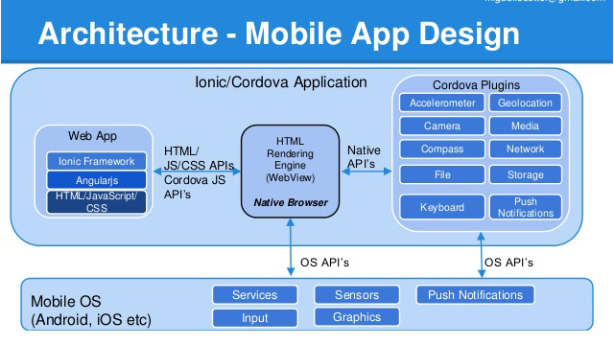
How it works (probably should draw it)

Slide 4

Structure
Same as Angular
Adds @IonicPage (a page in your app) that is actually an Angular @Component
Ionic subclassed the @Component class to make them easier to be used as a page in a Mobile App
Every page is a module (if u use Lazy Loading)

Slide 5
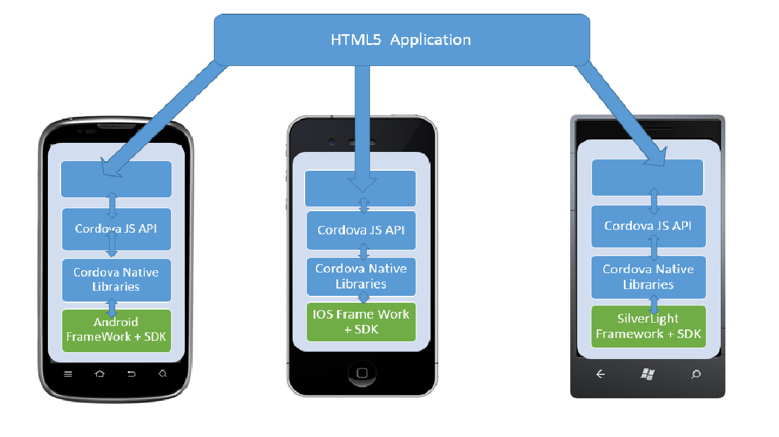
Last Slide I Promise then we’ll code

